Slide 1
Programming Fundamentals
By
Shazmeen Batool

Slide 2
Today’s Lecture
Programming Languages
C++ Program-Development Environment
Programming Style and Documentation
Programming Errors

Slide 3
Program
Computers process data under the control of sequences of instructions called computer programs.
These programs guide the computer through ordered actions specified by people called computer programmers.
The programs that run on a computer are referred to as software.

Slide 4
Programming Languages
Machine Language
Machine language is a low-level language made up of binary numbers or bits that a computer can understand.
The instructions are in binary code.
Such programs are highly difficult to read and modify for humans.
For example: A in binary code will be 01000001

Slide 5

Programming Languages
Assembly Language
Assembly language is the more than low level and less than high-level language so it is intermediary language.
Assembly languages use numbers, symbols, and abbreviations instead of 0s and 1s.
Assembler is used to convert assembly language into machine code.
For addition, subtraction and multiplications it uses symbols likes Add, sub and Mul, etc.
Example:
MOV eax, 3 MOV ebx, 4 ADD eax, ebx, ecx

Slide 6
Programming Languages
High-Level Languages
Are English like and easy to learn program.
For Example, following is a high-level language statement that computes sum of two numbers.
Sum = 3+4;
Translator programs called compilers convert high-level language programs into machine language.

Slide 7
Popular High-Level Languages
COBOL (Common Business Oriented Language)
FORTAN (FORmula TRANslation)
BASIC (Beginners' All-purpose Symbolic Instruction Code)
Pascal (named for Blaise Pascal)
Ada (named for Ada Lovelace)
C (developed by Dennis Ritchie)
Visual Basic (Basic-like visual language developed by Microsoft)
Delphi (Pascal-like visual language developed by Borland)
C++ (An object-oriented language, based on C)

Slide 8
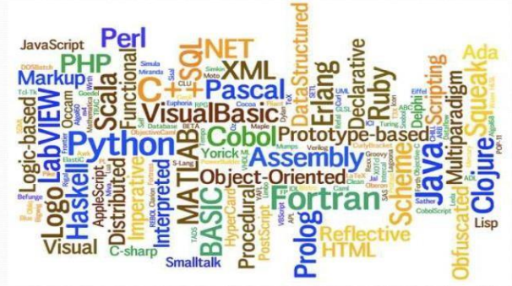

Slide 9
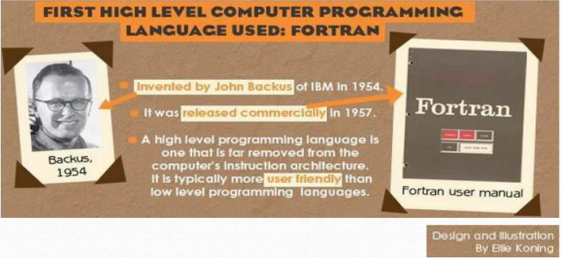
First High-Level Language

Slide 10
C++
C++ is one of today’s most popular software development languages.
C++, an extension of C, was developed by Bjarne Stroustrup in 1979 at Bell Laboratories.
Originally called “C with Classes”, it was renamed to C++ in the early 1980s.
C++ provides a number of features that “spruce up” the C language, but more importantly, it provides capabilities for object-oriented programming.

Slide 11
C++
C++ is widely used to develop systems that demand performance, such as operating systems, embedded systems, real-time systems and communications systems.

Slide 12
Typical C++ Program-Development Environment
C++ programs typically go through six phases to be executed:
Edit
Preprocess
Compile
Link
Load
Execute

Slide 13

Typical C++ Program-Development Environment
Phase 1: Editing a Program

Slide 14


Typical C++ Program-Development Environment
Phase 2 and 3: Preprocessing and Compiling a C++ Program

Slide 15

Typical C++ Program-Development Environment
Phase 4: Linking

Slide 16
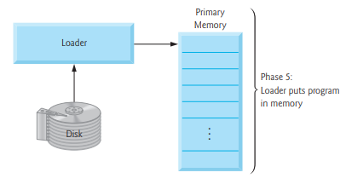
Typical C++ Program-Development Environment
Phase 5: Loading

Slide 17
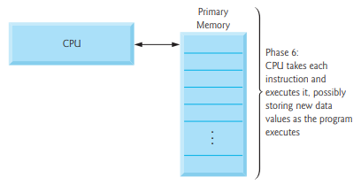
Typical C++ Program-Development Environment
Phase 6: Execution

Slide 18
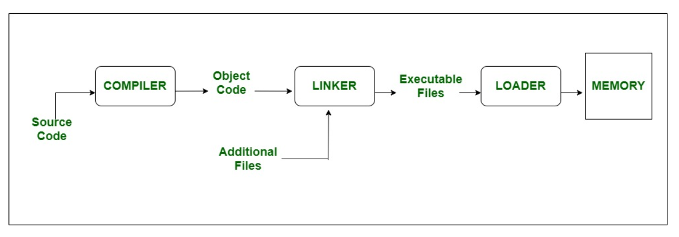
Compiling Source Code

Slide 19
Integrated Development Environment (IDE)
An IDE is a software program that is designed to help programmers and developers build software.
Most IDEs include:
A source code editor
A compiler
Build automation tools
A debugger

Slide 20
A Simple C++ Program
#include <iostream> // Pre-processor Directives
using namespace std;
int main() // Body of Program
{
cout<<“Welcome to C++”;
retrun 0;
}

Slide 21
Extending the simple C++ Program
#include <iostream>
using namespace std;
int main()
{
cout<<“Welcome to C++”<<endl;
cout<<“Welcome to C++ Builder!”<<endl;
cout<<“Welcome to C++ Compiler!”<<endl;
retrun 0;
}

Slide 22
Character | Name | Description
# | Pound Sign | Used in #include to denote a preprocessor directive.
<> | Opening and closing angle brackets | Encloses a library name when used with #include.
( ) | Opening and closing parentheses | Used with functions such as main().
{ } | Opening and closing braces | Denotes a block to enclose statements.
// | Double slashes | Precedes a comment line.
<< | Stream insertion operator | Outputs to the console.
“ ” | Opening and closing quotation marks | Wraps a string (i.e. sequence of characters)
; | Semicolon | Marks the end of the statement.

Slide 23

Programming Style and Documentation
Good programming style and proper documentation make a program easy to read and help programmers prevent errors
Appropriate Comments and Comment Styles
Proper Indentation and Spacing

Slide 24
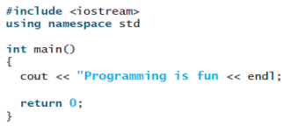
Programming Errors
Programming errors can be categorized into three types: syntax errors, runtime errors, and logic errors.
Syntax Errors:
Errors that are detected by the compiler are called syntax errors or compile errors. Syntax errors result from errors in code construction, such as mistyping a keyword, omitting necessary punctuation, or using an opening brace without a corresponding closing brace.

Slide 25
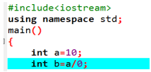
Programming Errors
Runtime Errors:
Runtime errors cause a program to terminate abnormally.
They occur while an application is running if the environment detects an operation that is impossible to carry out. Input mistakes typically cause runtime errors.
Another common source of runtime errors is division by zero.

Slide 26
Programming Errors
Logic Errors:
Logic errors occur when a program does not perform the way it was intended. Errors of this kind occur for many different reasons

Slide 27

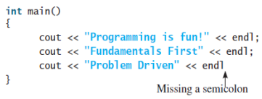
Common Errors
Common Error 1: Missing Braces
Common Error 2: Missing Semicolons

Slide 28


Common Errors
Common Error 3: Missing Quotation Marks
Common Error 4: Misspelling Names
C++ is case-sensitive. Misspelling names is a common error made by new programmers. For example, the word main is misspelled as Main in the following code

Slide 29
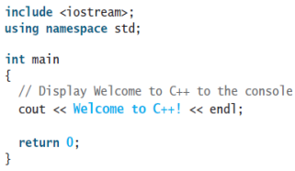
Tasks
Task 01
Identify and fix the errors in the following code:

Slide 30
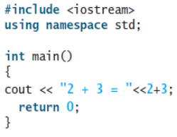
Tasks
Task 02
How do you denote a comment line and a comment paragraph?
Task 03
Reformat the following program according to the programming style and documentation guidelines.

